Slide 1
Adobe premiere pro y filmora
Carlos Antonio Tarqui Guillen
Dilan Elmer Poma Mamani
Brian Juan Carlos Oyardo Poma

Slide 2
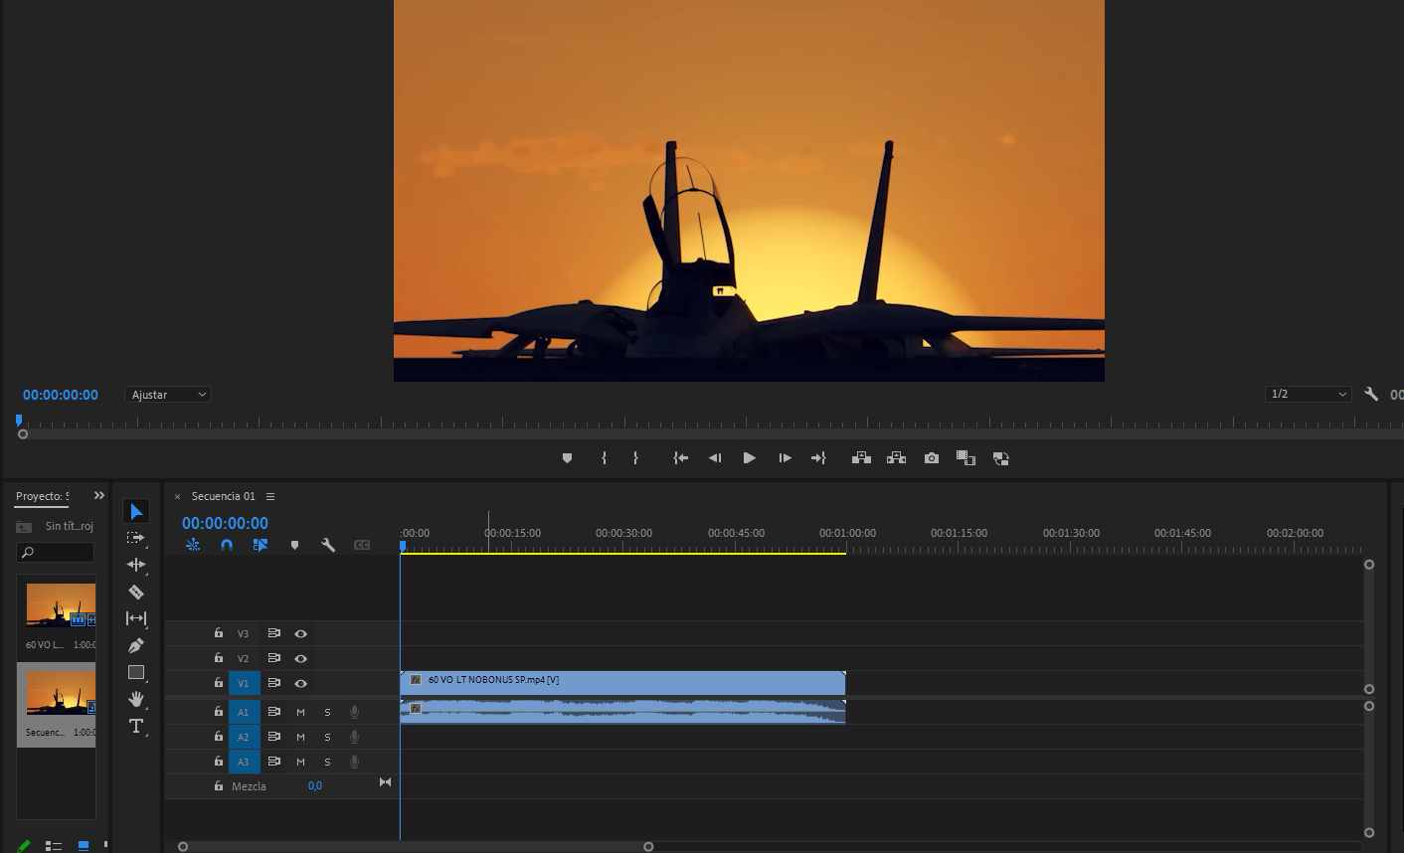
ADOBE PREMIERE PRO

Slide 3
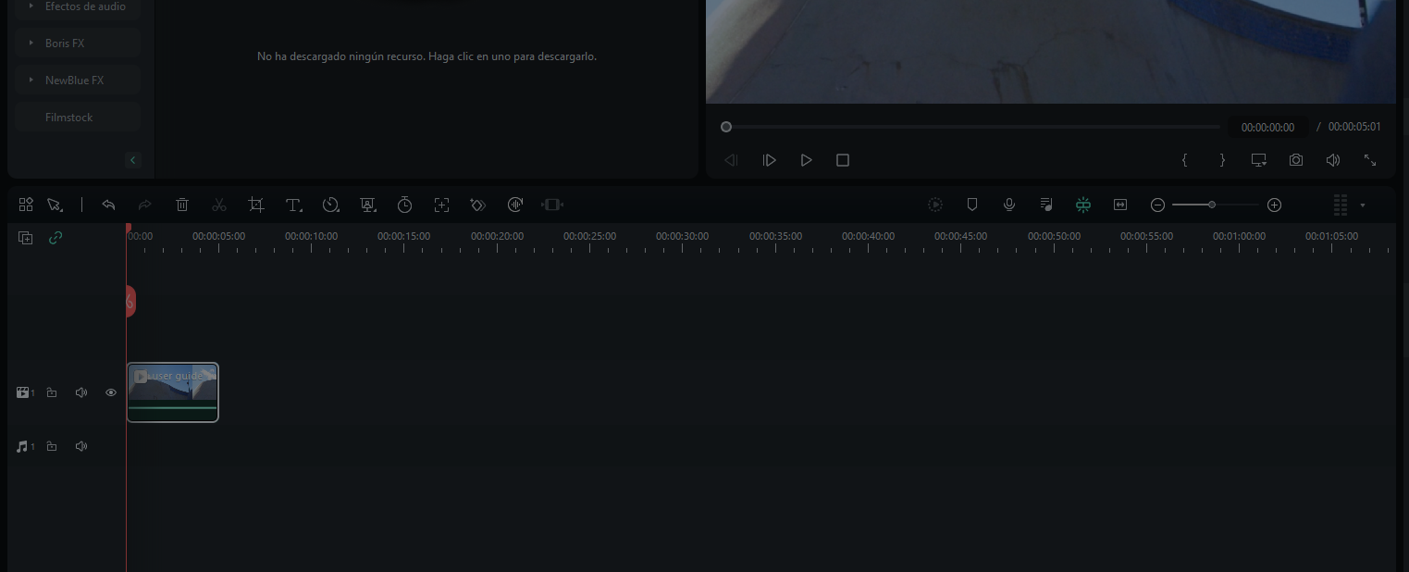
FILMORA

Slide 4

